Slide 1

Stratified Simple Random Sample
Stratified Sampling on 'soil-landcover' strata
Luis Rodriguez Lado - GSP

Slide 2
Sampling approaches
Model-based
Non-probabilistic
The sample distribution is optimised to make a statistical model more accurate
Assumes that the covariates represent the variability of our target soil property
It is useful for mapping the most probable values
Most common method: cHLS, geostatistics
Design-based
Probability sampling
The sample distribution is based on random distribution
Strata can represent the variability of the landscape
Useful for estimating parameters of the population (mean SOC of an area) or for validating an existing map.
Most common method: Stratified Simple Random Sampling

Slide 3
Agenda
What is Stratified Simple Random Sampling?
Advantages and Limitations
Types of Stratified Simple Random Sampling
Case Study
Contents in the exercise
Summary
Acknowledgements
References

Slide 4
What is Stratified Simple Random Sampling?
Stratified Simple Random Sampling:
Stratified simple random sampling is a method of selecting a representative sample from a population by dividing it into distinct subgroups or strata and then randomly selecting samples independently from each stratum.
Advantages:
Stratification ensures that each subgroup or stratum of the population is represented in the sample, leading to a more accurate representation of the entire population.
It's particularly useful when the population exhibits significant internal variability or diversity.
Stratification enables the analysis of subgroups within the population, which can be essential for drawing specific conclusions about different segments.
It can help reduce bias in the sample, ensuring that each part of the population has an equal chance of being included.
Stratified sampling can be more cost-effective than simple random sampling because it often requires smaller sample sizes to achieve the same level of precision.

Slide 5
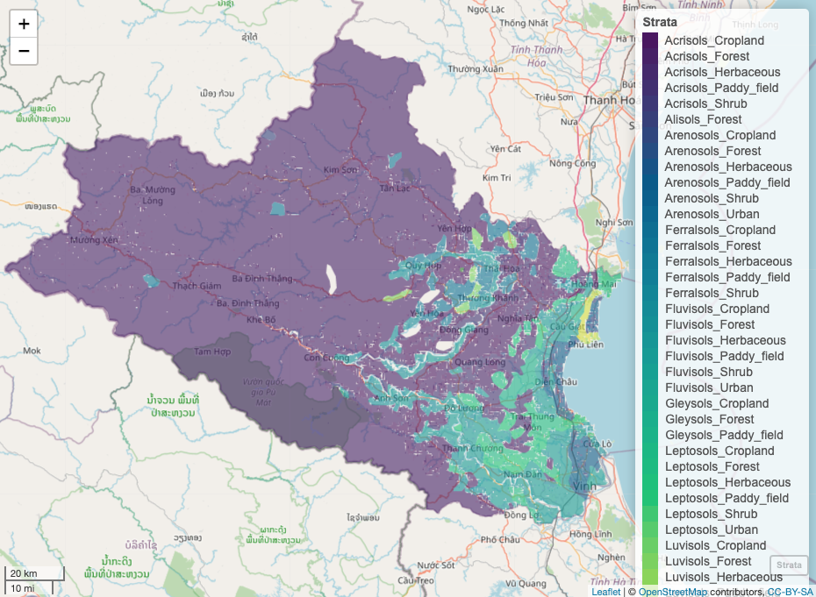
Soil - Landcover stratification
Strata Map

Slide 6
What is Stratified Simple Random Sampling?
Limitations:
Requires Knowledge of Strata: Stratified sampling assumes that strata are well-defined and known in advance. In cases where there are hidden or unknown strata, stratification may not be effective.
Complexity of Implementation: Stratified sampling can be more complex to plan and execute compared to simple random sampling, particularly when dealing with numerous strata or when the population is not well-defined or easily categorized.
Stratum Misclassification: Accurately categorizing units into strata can be challenging. Misclassification of units into inappropriate strata can introduce bias and reduce the effectiveness of stratification.
Resource Intensive: Depending on the number of strata and the need for precise representation, stratified sampling may require a larger budget and more resources than simple random sampling.
Loss of Some Randomness: Although stratified sampling maintains randomness within strata, the overall randomness of the sample can be reduced, especially when some strata are disproportionately sampled.
Limited Generalization: The results of a stratified sample may be less generalizable to the entire population compared to simple random sampling if strata do not cover the entire population space or if there are concerns about stratum misclassification.

Slide 7
Types of Stratified Simple Random Sampling?
Proportional Stratified Sampling: The size of each stratum's sample is proportional to the size of the stratum within the overall population (area weighted). Larger strata are allocated a larger proportion of the total sample size, while smaller strata receive a smaller proportion. This ensures that each stratum is represented according to its relative importance in the population.
Disproportionate Stratified Sampling: The sample sizes within each stratum are not necessarily proportional to their sizes in the population. Researchers may intentionally oversample certain strata that are of particular interest or importance, while allocating fewer samples to other strata. This can be useful when researchers want to ensure adequate representation of specific subgroups or when certain strata have higher variability and require more samples for precision.
Equal Allocation: This is a subcategory of proportionate stratified sampling where an equal number of samples is allocated to each stratum, regardless of the stratum's size. This approach ensures that each stratum has the same weight in the final sample.
Optimal Allocation: In some cases, researchers may use mathematical optimization techniques to determine the optimal allocation of samples to strata, considering factors like variability, cost, or precision.
Systematic Sampling Within Strata: Instead of using simple random sampling within each stratum, systematic sampling can be employed. In systematic sampling, you select every kth unit from each stratum, where k is determined based on the stratum's size and the desired sample size.
Cluster Sampling Within Strata: Occasionally, cluster sampling (sampling groups or clusters of units within each stratum) may be used in conjunction with stratification. This approach can be helpful when it is more practical or cost-effective to sample clusters of units within strata.
Sequential Sampling in Strata: In certain situations, especially when the population size is extremely large or data collection is expensive, sequential sampling methods might be employed within strata to gradually build the sample size while monitoring data quality.
Notes:
Stratified simple random sampling can be categorized into two primary types based on how the stratification is performed and how samples are selected within each stratum:

Slide 8
Types of Stratified Simple Random Sampling?
Proportional Stratified Sampling: The size of each stratum's sample is proportional to the size of the stratum within the overall population (area weighted). Larger strata are allocated a larger proportion of the total sample size, while smaller strata receive a smaller proportion. This ensures that each stratum is represented according to its relative importance in the population.
Disproportionate Stratified Sampling: The sample sizes within each stratum are not necessarily proportional to their sizes in the population. Researchers may intentionally oversample certain strata that are of particular interest or importance, while allocating fewer samples to other strata. This can be useful when researchers want to ensure adequate representation of specific subgroups or when certain strata have higher variability and require more samples for precision.
Equal Allocation: This is a subcategory of proportionate stratified sampling where an equal number of samples is allocated to each stratum, regardless of the stratum's size. This approach ensures that each stratum has the same weight in the final sample.
Optimal Allocation: In some cases, researchers may use mathematical optimization techniques to determine the optimal allocation of samples to strata, considering factors like variability, cost, or precision.
Systematic Sampling Within Strata: Instead of using simple random sampling within each stratum, systematic sampling can be employed. In systematic sampling, you select every kth unit from each stratum, where k is determined based on the stratum's size and the desired sample size.
Cluster Sampling Within Strata: Occasionally, cluster sampling (sampling groups or clusters of units within each stratum) may be used in conjunction with stratification. This approach can be helpful when it is more practical or cost-effective to sample clusters of units within strata.
Sequential Sampling in Strata: In certain situations, especially when the population size is extremely large or data collection is expensive, sequential sampling methods might be employed within strata to gradually build the sample size while monitoring data quality.
Notes:
Stratified simple random sampling can be categorized into two primary types based on how the stratification is performed and how samples are selected within each stratum:

Slide 9
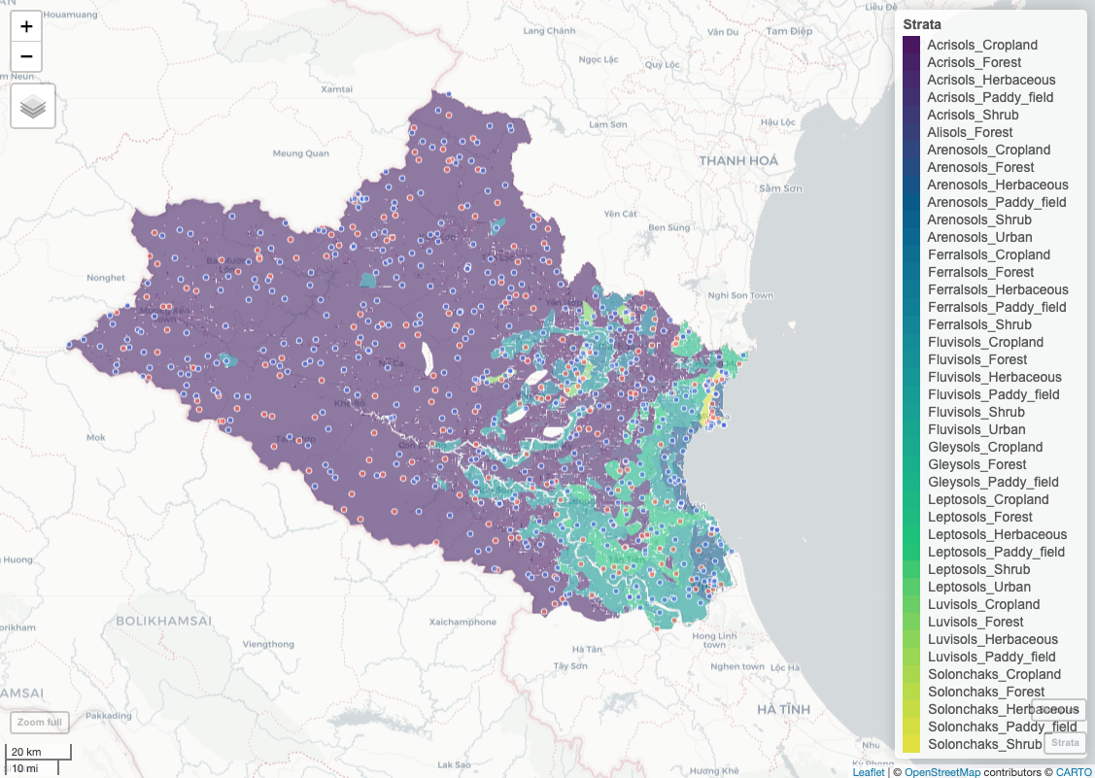
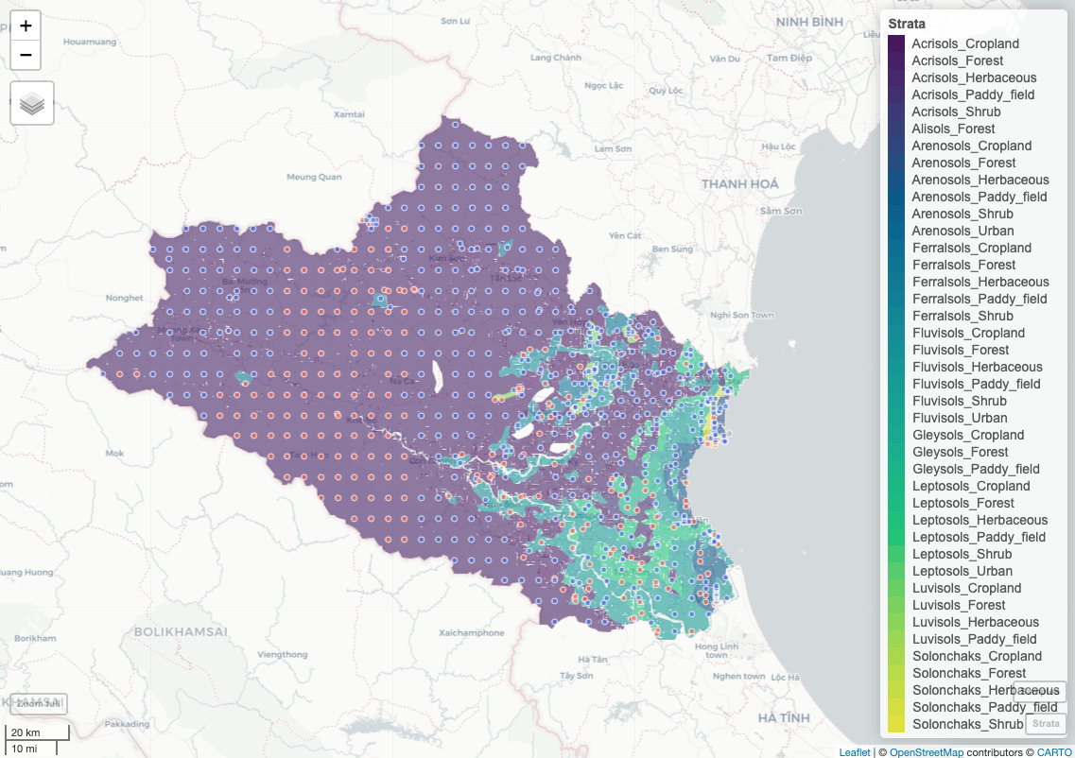
Random vs Regular Stratified Sampling
Stratified simple random sampling design
Stratified simple regular sampling design

Slide 10
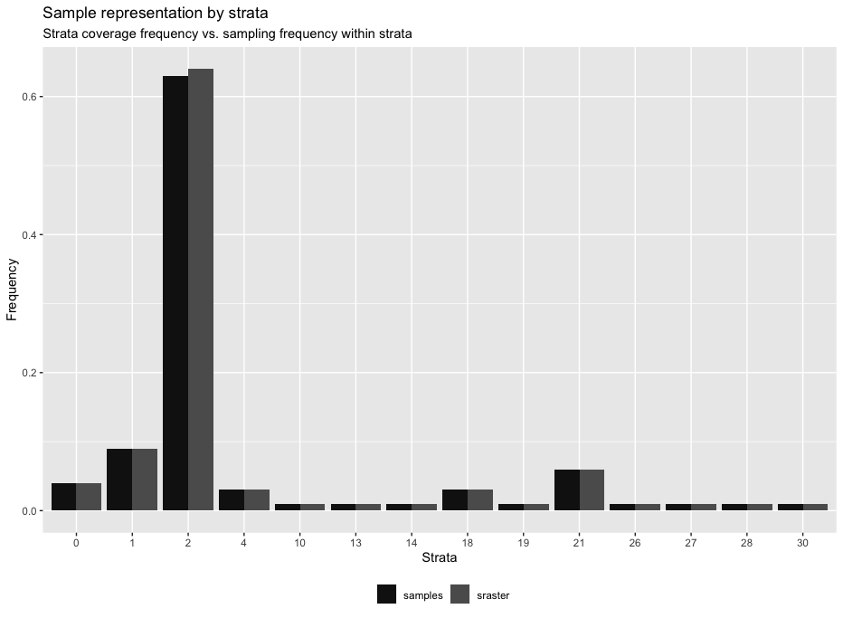
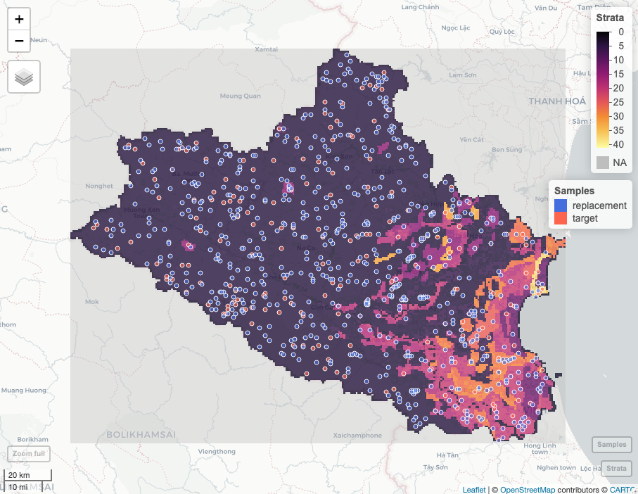
Random Sampling based on stratified raster data
sample_str (sgsR package): area weighted random sampling on raster strata
Histogram of samples over strata
Stratified simple regular sampling design

Slide 11
Case study
Training material in ‘Nghe An’ District (Vietnam)
68 environmental parameters (Available at as GEE assets)
Shapes of province boundaries.
R packages:
sgsR
clhs

Slide 12
Contents in the exercise
Delineation of soil strata.
Delineation of landcover strata.
Creation of soil-landcover strata
Stratified Random Sampling on soil-landcover strata (Dick Brus).
Stratified Regular Sampling on soil-landcover strata (Dick Brus).
Stratified Random Sampling on soil-landcover raster strata (sgsR).

Slide 13
Summary
Stratified simple random sampling is advised when you want to enhance the representativeness and precision of your sample in situations involving complex populations with subgroups or when you have specific objectives related to different segments of the population. It is a valuable tool for researchers and surveyors seeking to obtain reliable and accurate information from diverse or heterogeneous populations.
Strata must be well-defined and known in advance. In cases where there are hidden or unknown strata, stratification may not be effective.
Stratification enables the analysis of subgroups within the population, which can be essential for drawing specific conclusions about different segments.

Slide 14
Acknowledgments
We want to acknowledge the following authors for the distribution of the R scripts/data included partially in this manual.
@Dick Brus
Vietnam

Slide 15
References
Goodbody, T.R., Coops, N.C. & Queinnec, M. 2023. Structurally guided sampling (available at https://cran.r-project.org/package=sgsR).
Brus, D.J. 2023. Spatial Sampling with R (https://dickbrus.github.io/SpatialSamplingwithR/).

Slide 16
Index of the script
0 - Set working directory and load packages
1 - User-defined variables
2 - Import data
3 - Delineate soil strata
4 - Delineate land/cover strata
5 - Create sampling strata
6 - Accommodate strata to requirements
7 - Stratified random sampling
8 - Calculate replacement areas for points
9 - Stratified regular sampling
10 - Stratified random sampling on raster strata

Slide 17
Contact Information
luis.rodriguezlado@fao.org
marcos.angelini@fao.org

